Slide 1
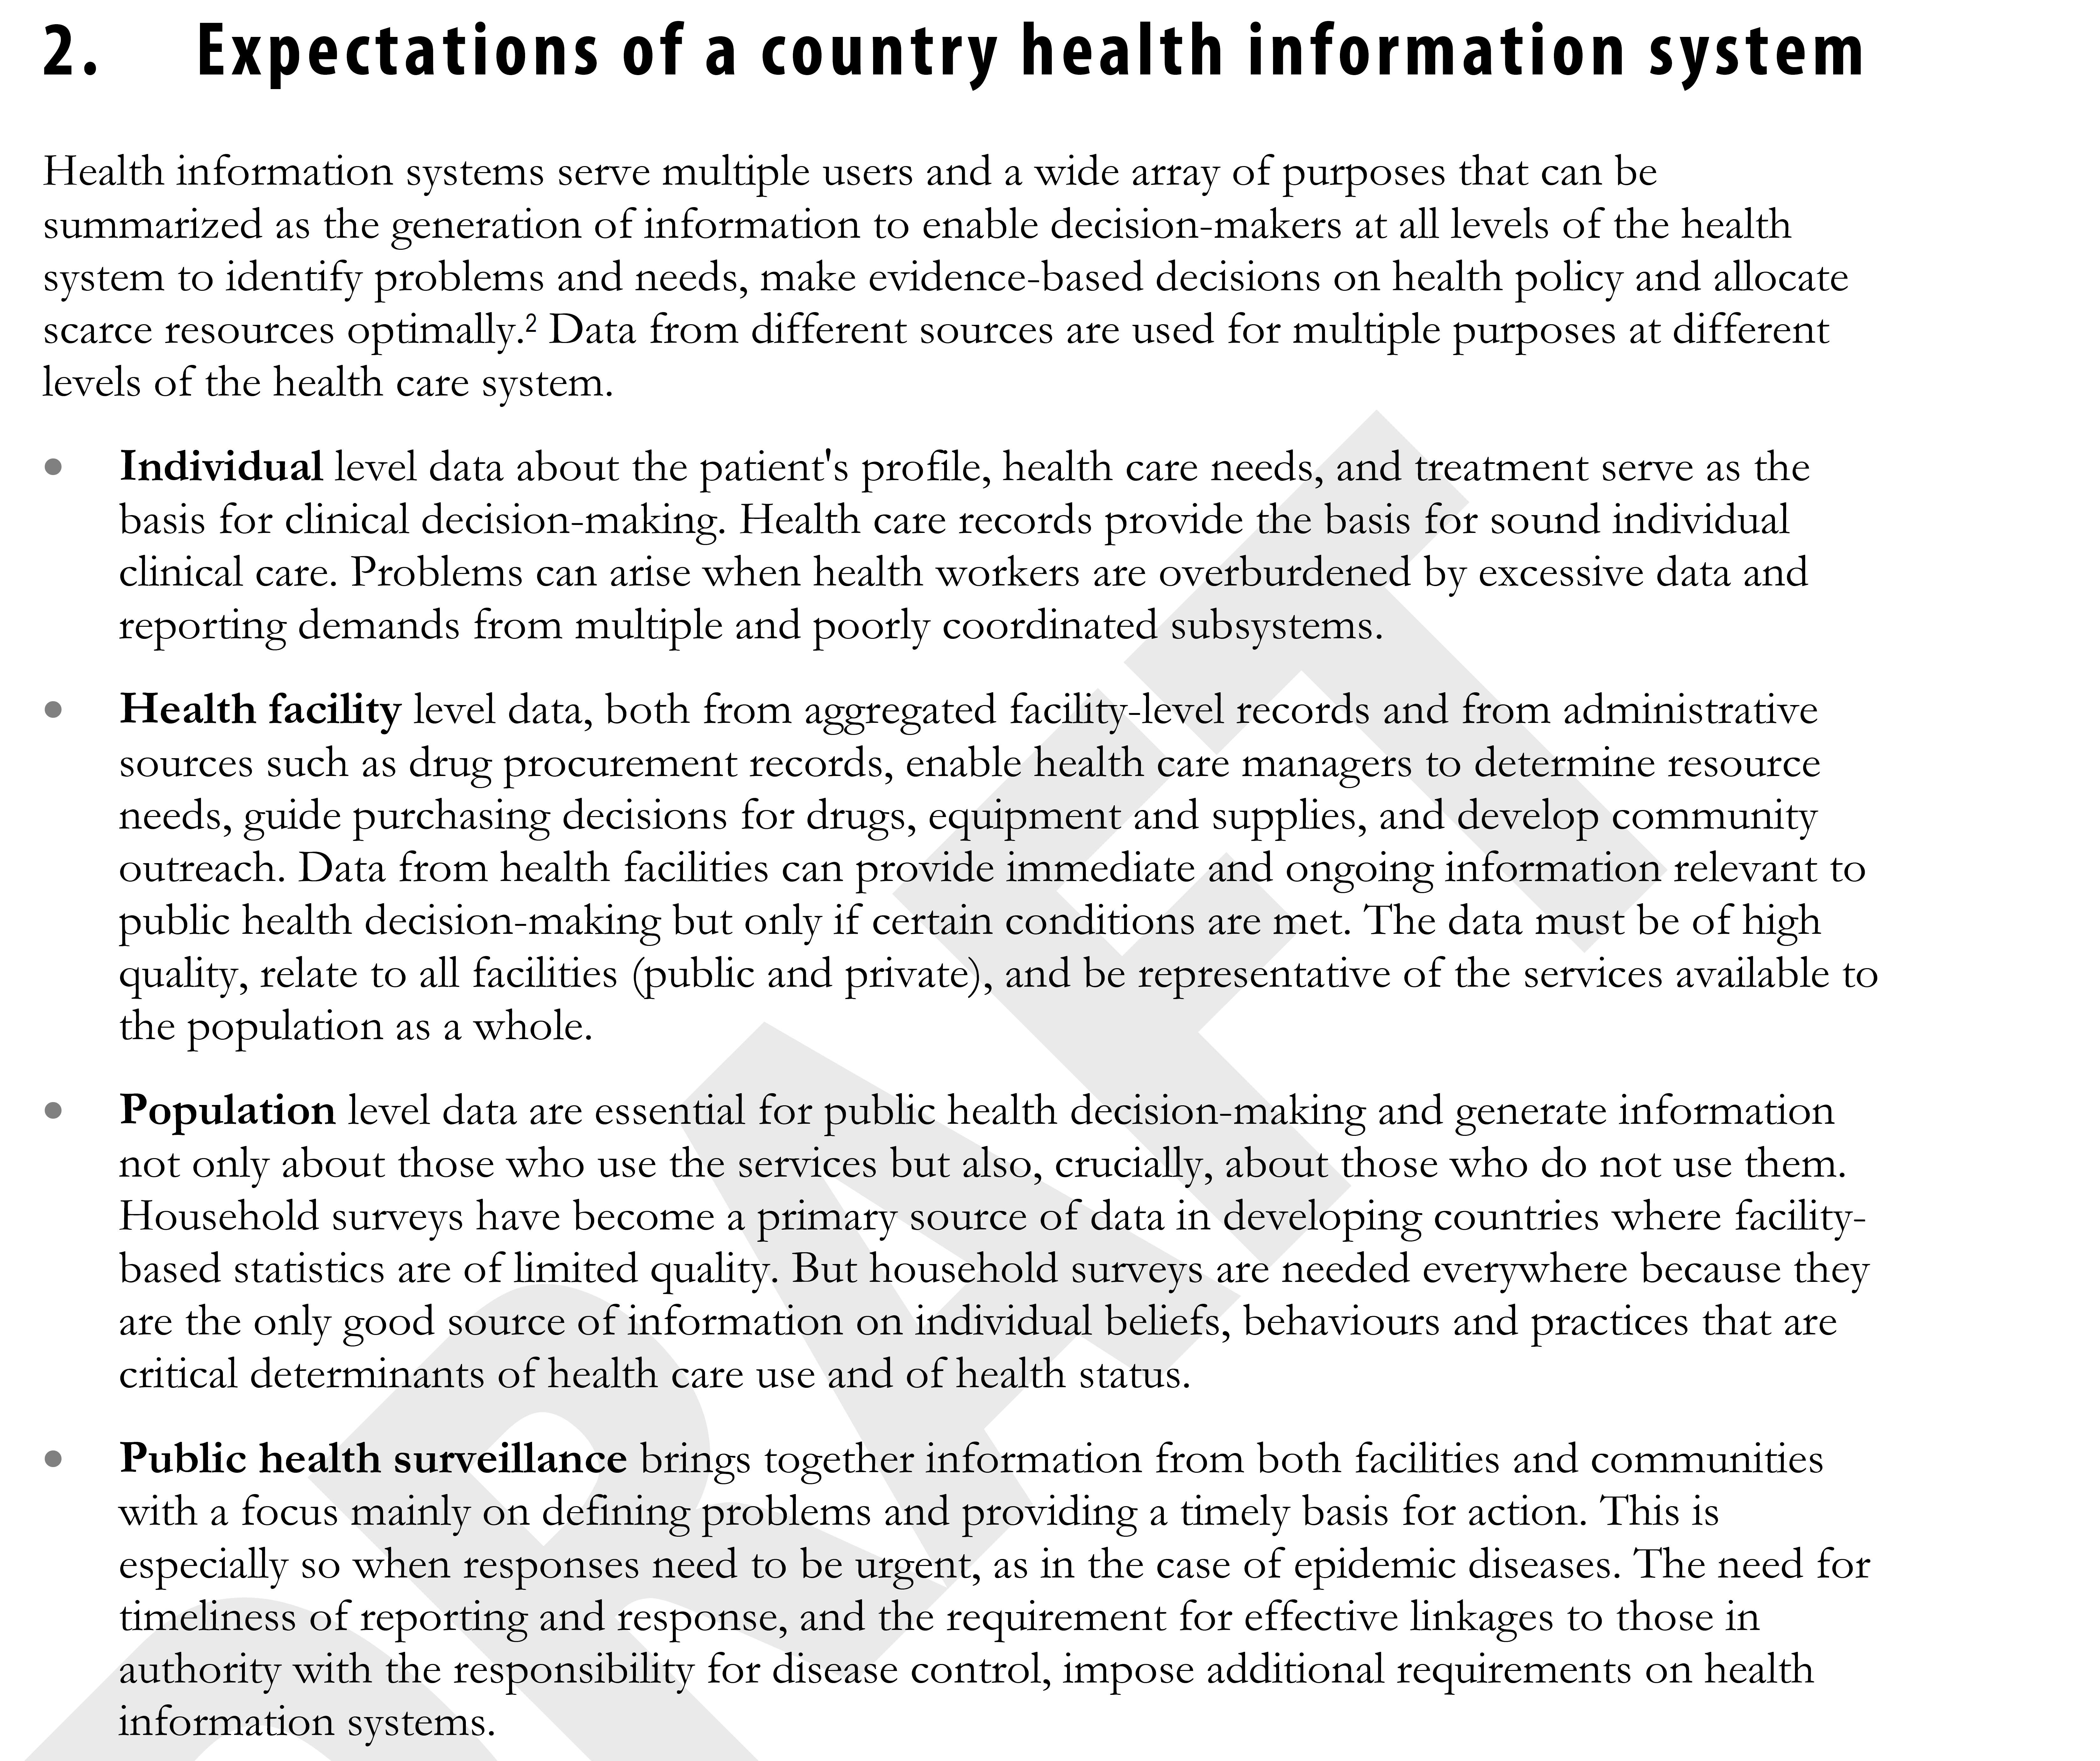
Health management information systems
Countries have always generated/used data.
Nationalized systems garnered global attention beginning in mid-1990s.
Standardize processes
Common indicators
Universal systems such as DHIS2

Slide 2
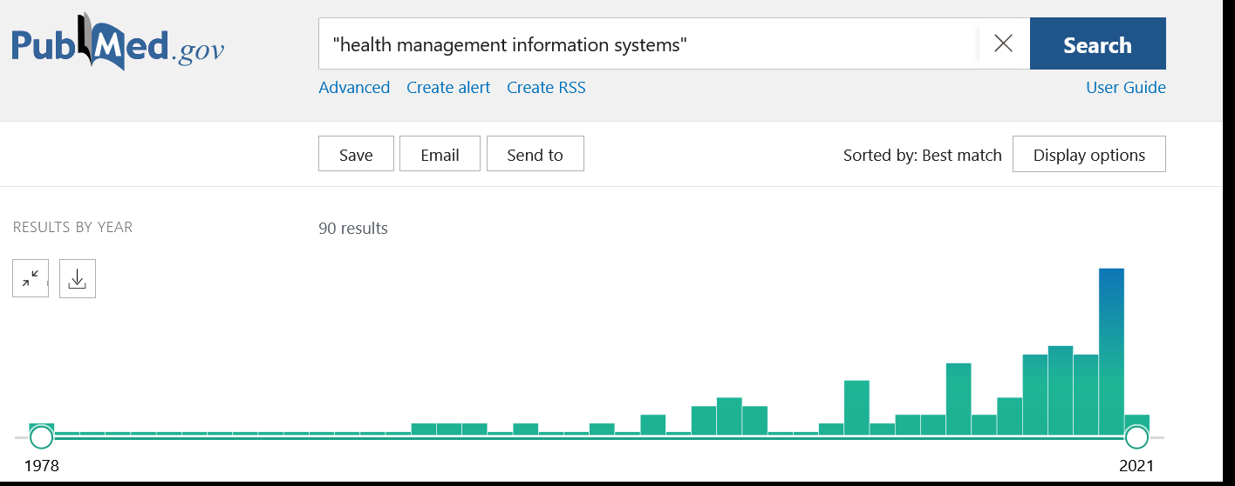
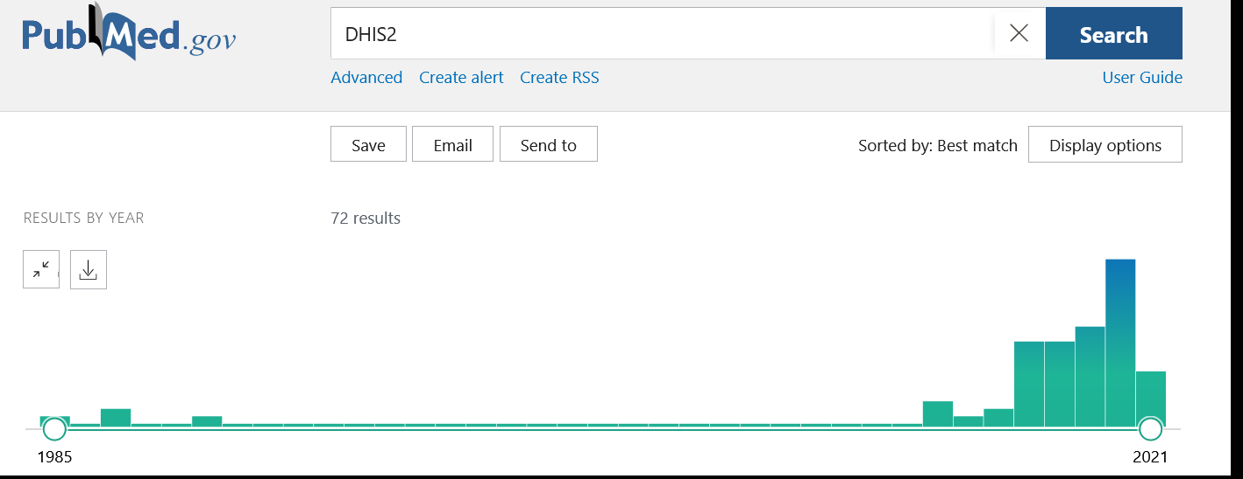

Slide 3
Flow of HMIS data
Patient File
District Report
Facility registers/
Aggregate facility report
Patient File
Patient File
Patient File
Facility registers/
Aggregate facility report
Electronically entered
Facility registers/
Aggregate facility report
Notes:
3

Slide 4
Flow of HMIS data
Patient File
Facility registers/
Aggregate facility report
Electronically entered
Patient File
Patient File
Patient File
Facility registers/
Aggregate facility report
Facility registers/
Aggregate facility report
Notes:
4

Slide 5
Quality of data recorded?
Is it complete?
Is it valid?
Is it reliable?
Is it accurate?
Level of difficulty
5
Notes:
Note to facilitator:
Describe how data quality can undermine the quality of an indicator.
Completeness – is there something in the field?
Valid – is what is in the field in a plausible range?
Reliable – is what is in the field consistent with another source?
Accurate – is what is in the field reflecting the truth?
Quality is harder to assess as you move up the chain.

Slide 6
Completeness and validation

Slide 8
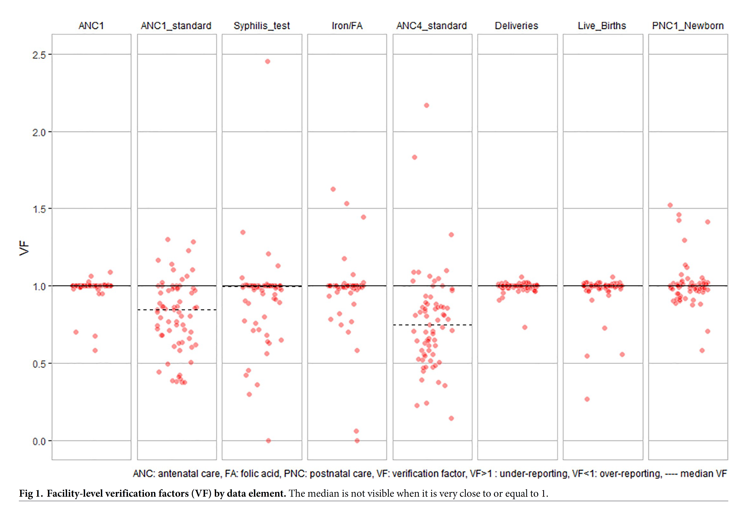
Reliability

Slide 9
Accuracy

Slide 10
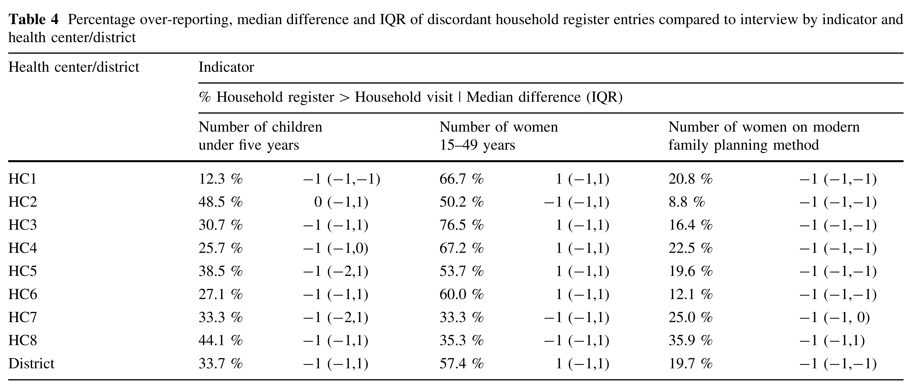

Slide 11
High-level thoughts on HMIS quality
There is no such thing as perfect data.
Important to monitor quality of your data:
Good enough to use?
Ways to improve?
Even imperfect data can be usable data.
Can throw out clear mistakes.
If bias is consistent, then can still detect outliers.
May be able to fill in missing values.

